Slide 1
3
PROBLEMS INVOLVING LOOPING

Slide 2
INTRODUCTION
The term iteration means repetition.
Sometimes, a procedure should be executed repeatedly.
All procedures should be built so that they can be repeated as many times as needed.
We should not develop procedures to execute only once. Otherwise, calculators could be sufficient to obtain the results.
An iterative logic structure is also known as a loop.
Looping means repeating a set of operations to obtain a result repeatedly.
An iteration may be implemented in two ways:
a pre-test iteration;
post-test iteration.

Slide 3
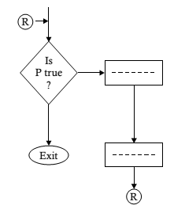
FLOWCHARTING AND ALGORITHMS
In case of a pre-test iteration, a predicate is tested to decide whether a set of operations is to be performed or not.
If the condition implied by the predicate is true, then the desired operations are performed. If it is false, then the iteration is terminated.

Slide 4
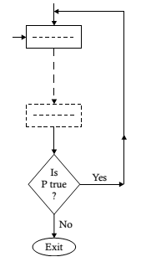
FLOWCHARTING AND ALGORITHMS
For a post-test iteration, the predicate is tested after performing a set of operations once to decide whether to repeat the set of operations or to terminate the repetition.
If the condition happens to be true, then the set of operations is repeated; otherwise, it is not repeated. The diagrammatic structure of this logic is as follows.
Note that the operations in the loop must be performed at least once in the case of a post-test iteration.

Slide 5
FLOWCHARTING AND ALGORITHMS
The concept of looping is demonstrated in the following flowchart.
Of course, there should be a condition for normal termination. Let us assume that the repetitive task of calculating the discounts and net prices is terminated when we provide negative or zero as the price for the input.
Such absurd values are justified for the termination of loops so that the procedure can remain valid for any possible value of the price.
We usually use out- connectors and in-connectors with the same label to demonstrate the end point and start point of a loop.

Slide 6
EXAMPLE
Problem 2.11. A bookseller offers two rates of commissions. If the price of a book is below $100, the rate of commission is 12% of the price, otherwise, it is 18% of the price. Develop a procedure to determine the discount and the net price of a book.
Step 1. REPEAT STEPS 2 THROUGH 6 {Start Loop}
Step 2. INPUT TO P
Step 3. IF P ≤ 0 THEN
EXIT {Stop Repetition, i.e., transfer the control to STOP}
Step 4. IF P < 100 THEN
COMPUTE D ←P*0.12
ELSE
COMPUTE D ←P*0.18
END-IF
Step 5. COMPUTE NET_PRICE ←P – D
Step 6. PRINT D, NET_PRICE (End of loop)
Step 7. STOP

Slide 7
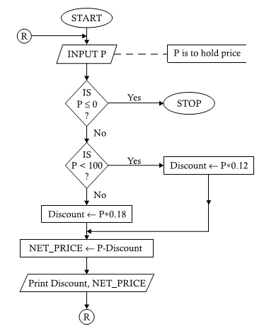
EXAMPLE
Note that the out-connector shows the end point of the loop and the in-connector. shows the start point of the loop.
The operations starting from the point of the accepting the input price up to the points of printing the output discount and net price are within the loop. It could have been demonstrated without using connectors.
However, we prefer the first flowchart to the following one, because if the flowchart cannot be accommodated on a single page (or in a continuous structure on a single page), it would be difficult or impossible difficult to connect the start point and the end point.

